Slide 1

Theory of Production
Name : Agrawal Megha B.
Enrollment no. : 160410116003
Sub : EEM.
Class : SY IT – 1.

Slide 2
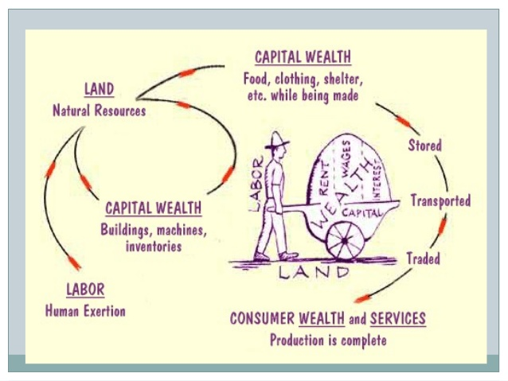

Slide 3
Introduction
“The production is a process of transforming of raw materials into finished goods through the step-by-step conversion using the resources such as men, machines and technology.”
It is the process in which the inputs are converted into outputs.

Slide 4
Production function means the functional relationship between inputs and outputs in the process of production.
It is a technical relation which connects factors inputs used in the production function and the level of outputs
Q = f ( Land , Labour , Capital ,Organization , Technology , etc.)

Slide 5
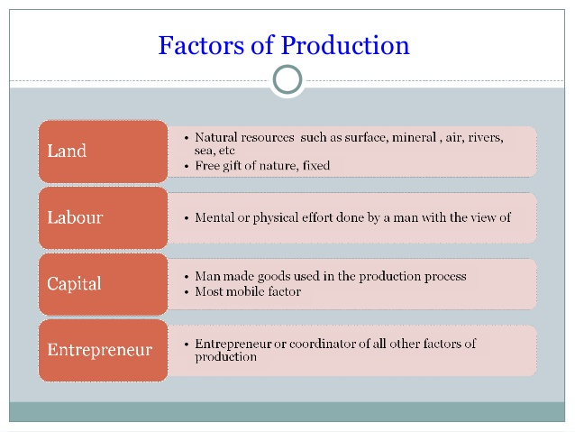

Slide 6
Land
Meaning: according to Marshall, land stands for all natural resources which yield an income.
Characteristics: *nature’s gift
*limited
*no supply price
*permanent
*lacks of mobility
*margin of cultivation

Slide 7
HOW ARE GOODS PRODUCED?
Land:
The “gift of nature” that we use to produce goods and services. All the things we call natural resources.
Comes from the air , water , or the earth.
Land , minerals , water
Renewable
Water , air growing things
Non-Renewable
coal , oil

Slide 8
Labour
Meaning: work whether manual or mental, which is undertaken for a monetary consideration…
Characteristics: *connected with labourer
*can’t preserve
*has weak bargaining power
*price of labour react rather
curiously on its supply

Slide 9
HOW ARE GOODS PRODUCED?
Labour:
Work time and work effort that people devote to producing goods and services
People’s efforts, labour
Effort can be physical or mental

Slide 10
Capital
Meaning: wealth which is used in producing further wealth
Term used for: plant and machinery, tools and accessories, stocks and row material…
Characteristics: *role in modern productive
system
*production is not possible
without capital
*creation of employment
opportunities in the country

Slide 11
HOW ARE GOODS PRODUCED?
Capital:
Physical capital: what tools, machines and factories will you needed to create your product
Financial capital: funds the firm use to buy physical capital
Human capital: what knowledge, skills, education and experience will your employees need to have in order to produce your product

Slide 12
Entrepreneur
What he/s do???
Co-ordinate and co-relate the other factors of production.
Starts the work @organize it @supervise it.
Functions:
Commence a business enterprise by developing new product or by modifying the exiting product.
Took the final responsibility.
As innovator.

Slide 13
HOW ARE GOODS PRODUCED?
Entrepreneurship:
The human resources that organized and combines labour, land, capital.
* The quantity and quality of entrepreneurship
is hard to describe and measure.
*But we can easily recognize brilliant
entrepreneurs by their enormous financial
success.

Slide 14
Law of variable proportions
The law of variable proportions is based on the cost behavior of the inputs applied in the production.
The law of variable proportions establishes a relative relationship between the variable factor and the fixed factors in the ratio form.
The law of variable proportions is a short-term analysis.

Slide 15
Law of returns to scale
The law of returns to scale is an extension of the law of variable proportion.
There are three phases of returns to scale of production:(1)Law of increasing returns (2) Law of constant returns and (3)Law of decreasing returns.
For simple explanation of these laws, two factors of production are considered-worker (w) as a variable factor and land (l) as a fixed factor which can be changed, proportionately.
The application of worker will change in proportion to the change in output, but the application of land will increase proportionately.

Slide 16
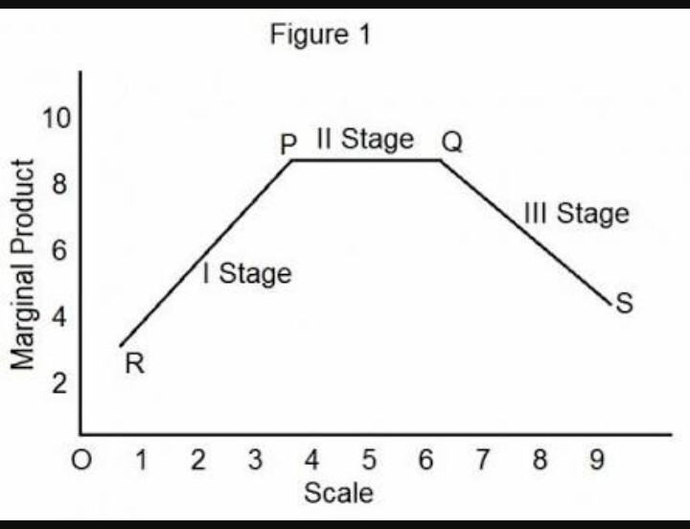

Slide 17
Case study
Analysis of the production theory for the electricity sector. A case study of Tenaga Nasional Berhad (TNB), Malaysia.
The purpose of this investigate the elasticities among the production factors in Tenaga Nasional Berhad (TNB), Malaysia. We applied the time series data for production (Q), capital (K), and labour (L) for the 1980-2009 period.
However, there is a long run relationship between the production level and its factors.

Slide 18
Elasticities analysis shows that the coefficient of the capital and labour influence Malaysian electricity production in the long run but labour shows more influence than capital.
Also, the TNB Company applied increasing return to scale for the electricity production.
Furthermore, there is evidence to support the effectiveness of the production function for the TNB.

Slide 19
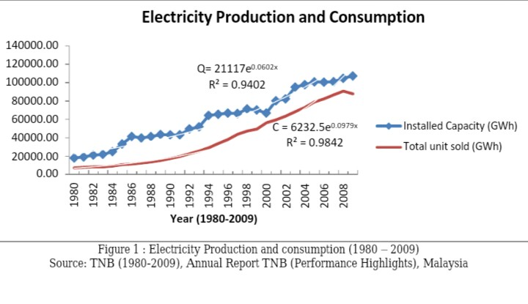

Slide 20


